Slide 1
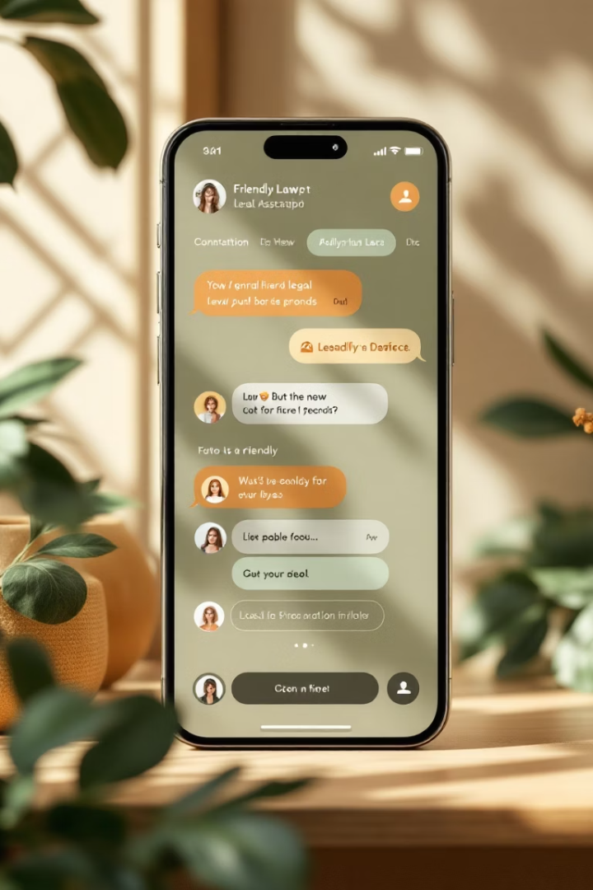
Introducing Justice Assist: Your Conversational Legal Assistant
Justice Assist is a chat-based web app designed for easy legal queries. Built with Streamlit, it offers advanced Large Language Models for insightful legal help.

Slide 2

Bridging the Gap: Legal Insights Made Accessible
User Empowerment
Real-Life Analysis
Helps users understand legal topics through natural conversation.
Examines real incidents from a legal perspective clearly.
Jargon Simplification
Transforms complex legal terms into simple language.

Slide 3
Powering Justice Assist: LLaMA 3.2 and Gemini API
LLaMA 3.2 via Groq
Gemini API
Enables high-speed, accurate model inference with low latency.
Provides enhanced legal knowledge and reasoning capabilities.

Slide 4




Ensuring User Safety: AI Limitations and Disclaimers
AI Limits
Legal Counsel Encouragement
Clearly informs users about AI-generated advice limitations.
Promotes consulting qualified attorneys for final decisions.
Safeguards
Prevents misuse and misinformation through built-in protections.

Slide 5
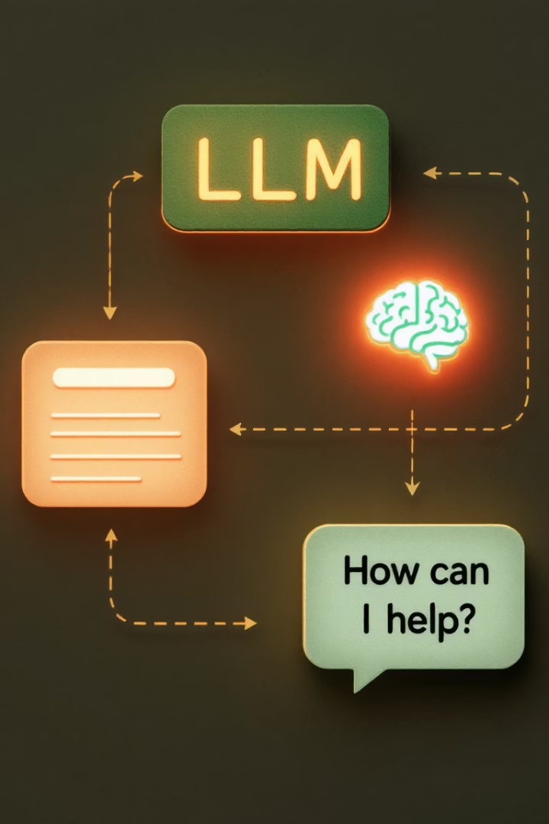



Under the Hood: Architecture and Workflow
User Input
Users submit queries through an intuitive chat interface.
Query Analysis
LLM processes natural language and retrieves legal insights.
Response Delivery
Answers are formatted and displayed conversationally for clarity.

Slide 6
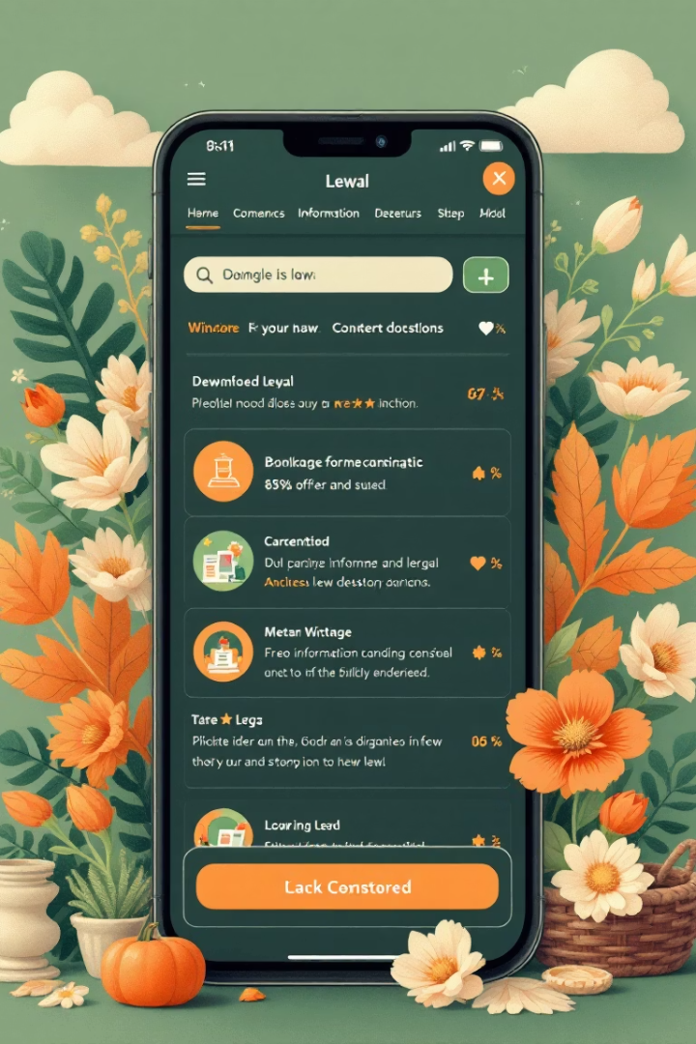



Key Benefits: Accessibility, Speed, and Clarity
Accessibility
Eases access to preliminary legal information for all users.
Speed
Provides rapid legal insights for timely decision-making.
Clarity
Simplifies complex concepts into straightforward explanations.

Slide 7



The Future of Justice Assist: Expanding Capabilities
Multilingual Support
2
Extending usability across languages and jurisdictions.
Database Integration
1
Connecting with legal databases for richer data accuracy.
Specialized Modules
Developing tools like contract reviews for specific use cases.
3

Slide 8

Conclusion: Empowering Informed Decisions
Legal Understanding
Justice Assist supports knowledge but doesn't replace attorneys.
Join the Movement
Be part of making legal help accessible worldwide.
Explore Justice Assist
Experience the power of conversational legal AI today.

